Slide 1
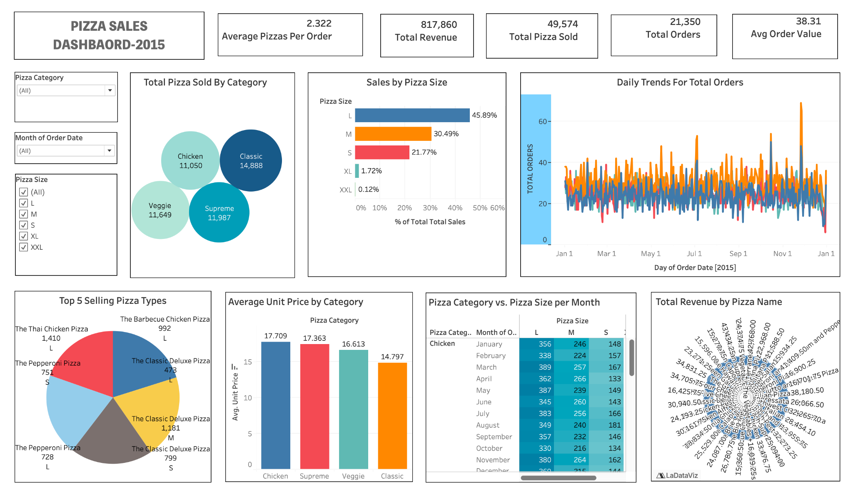
Pizza Sales Dashboard – 2015
Overview of Sales, Orders, and Revenue Performance

Slide 2
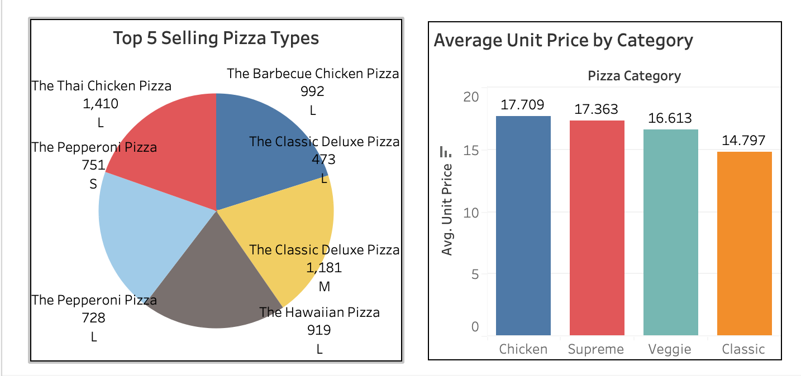
Key Insights (What & Why)
Overall business performance is strong, with high total revenue, a large number of pizzas sold, and an average of more than two pizzas per order.
Standard sizes (L, M , S) contribute the majority of sales, while a few categories, like Classic and Veggie, and a small set of top pizzas, drive a big share of demand.

Slide 3
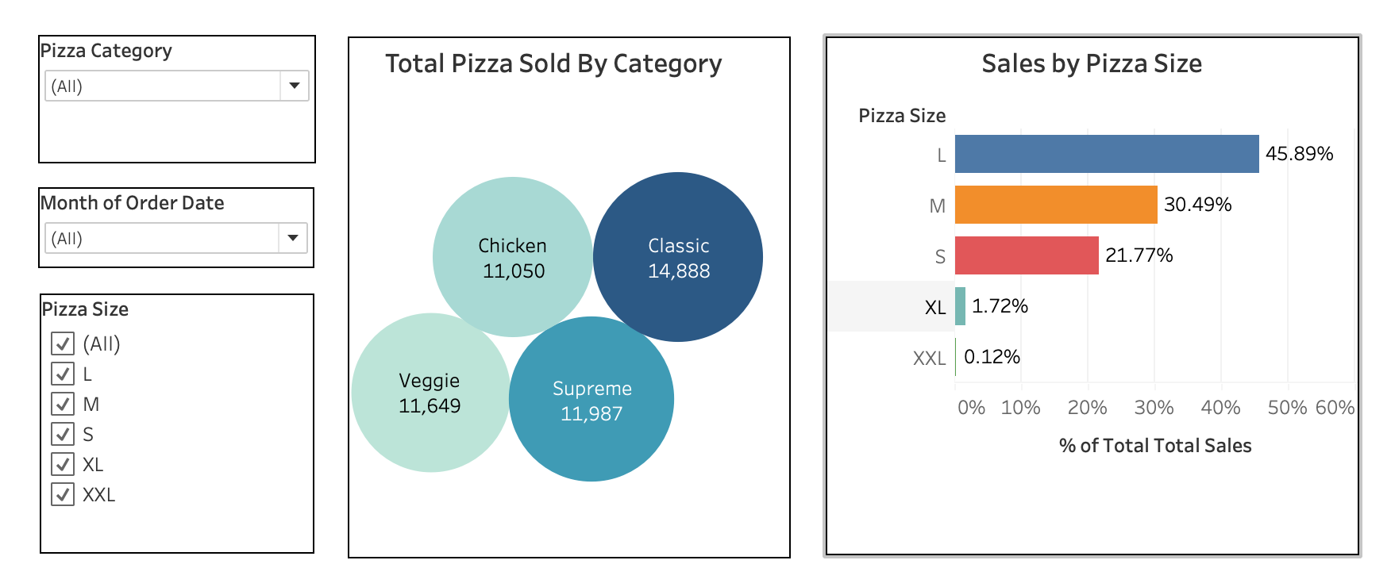
How This Dashboard Helps
Stakeholders can start with KPIs to check overall health, then drill down into categories, sizes, and specific pizzas to find growth opportunities.
The visuals support decisions on menu optimization, pricing, and marketing by highlighting best sellers, underperformers, and customer preferences.
By turning raw transactional data into clear visuals, the dashboard enables data‑driven planning rather than guesswork.

Slide 4
Conclusion
The pizza sales dashboard demonstrates that 2015 was a profitable and well‑performing year, with strong total revenue, a high volume of pizzas sold, and customers typically ordering multiple pizzas per transaction.
It clearly highlights that standard sizes and a few key categories and pizza types drive most of the business, giving managers a focused set of products to protect, promote, and keep in stock. By combining KPIs, product‑mix visuals, and time‑trend charts with interactive filters, the dashboard turns raw order data into practical, data‑driven guidance for decisions on menu design, pricing, marketing, and operational planning.

